Slide 1
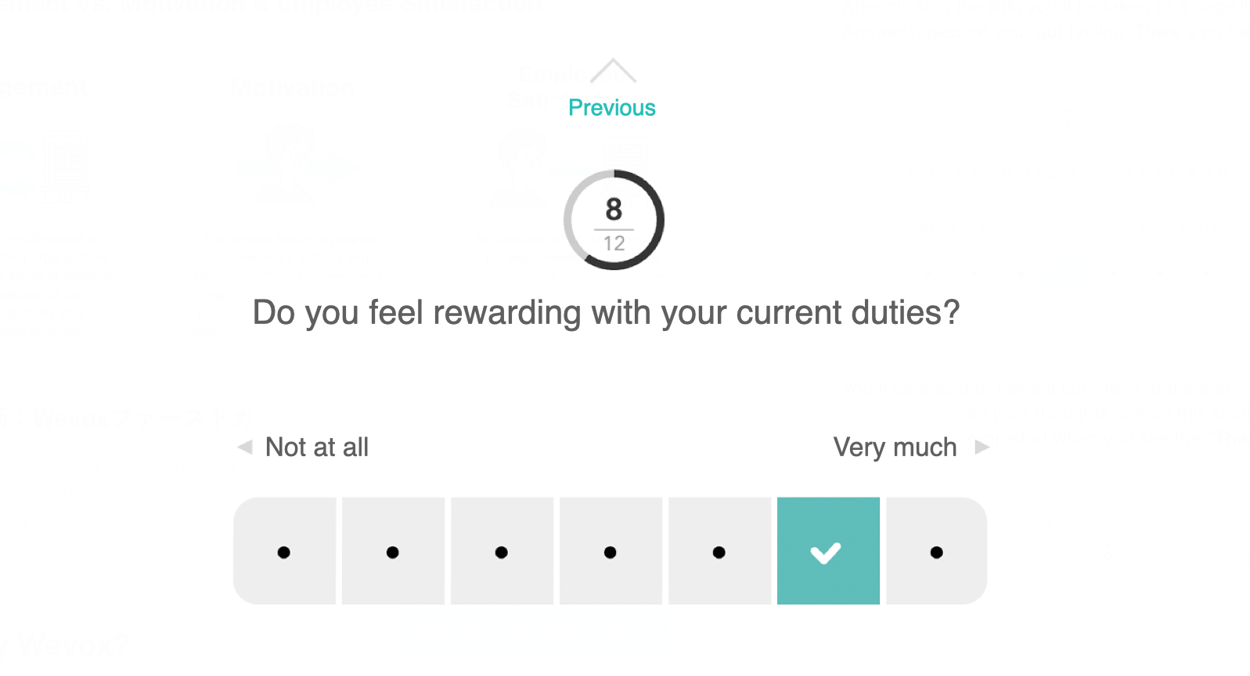
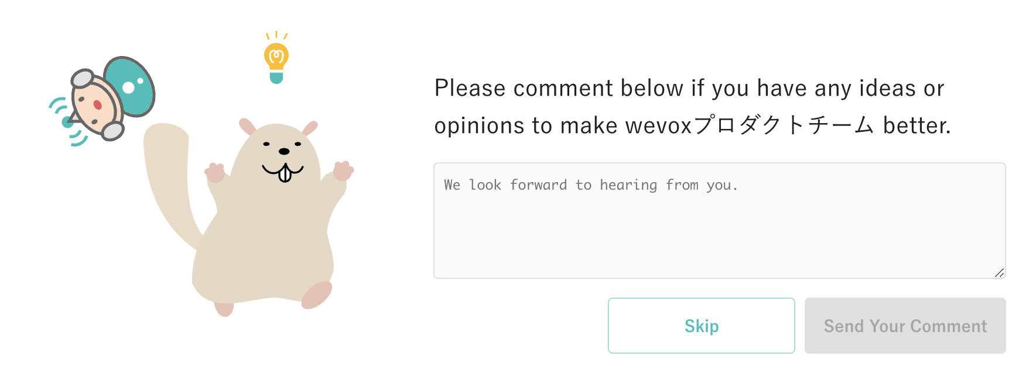
Trial Introduction
These boxes are here to help you fill out the form. Be sure to delete them before you share it!
20XX.XX.XX
Enter today's date here.
1
Wevox & Engagement
4
Accessing the Survey
Please edit as necessary.
Wevox helps organizations improve by measuring engagement through short, easy surveys. The results provide a visualization of your teams' morale and how you're performing, while highlighting areas for growth and improvement.
A link to the survey will be sent out via email or Slack.
You can access the link from your PC, tablet or smartphone.
Each recipient will receive a unique URL that cannot be shared.
Your responses won't be used to evaluate you personally, so you can answer openly and honestly with peace of mind!
Survey Sample
Engagement Vs. Motivation & Satisfaction
After clicking the link, you'll be taken to a page like this one. Answer based on your gut feeling! There's no need to overthink it.
Engagement
Motivation
Satisfaction
Selecting an answer will send you to the next question.
An individual's willingness to contribute to their organization and work with a sense of initiative.
The driving factor or purpose behind one's actions and decisions.
An indicator of satisfaction with job responsibilities and work environment.
You'll be asked to leave a comment at the end.
Feel free to share your thoughts or skip this section.
The survey is completed when you see the "Thank you!" screen.
Leave a comment below if you have any ideas or opinions to help improve the team.
2
Why Try Wevox?
Add your own reasons here.
・To benefit from visual representations of organizational health.
・To consider Wevox as a potential tool for organizational improvement.
Please edit as both sections as necessary. Example: Engagement score data will be viewed by HR and management.
5
Next Steps
Edit this information as necessary.
Trial Overview
Please list a date and time.
・Decision regarding the continued use of Wevox.
・If service is continued, surveys will be sent out (No. of times per month/specific day).
・Further details regarding Wevox will follow.
3
・A trial survey will be sent out on (MM/DD) at (0:00).
・Please answer all 32 questions. I should only take a few minutes!
・Survey answers and comments will be (public/anonymous).
・Engagement score data will be viewed by (names).
Thank you! Your voice can help improve our organization.

Slide 2
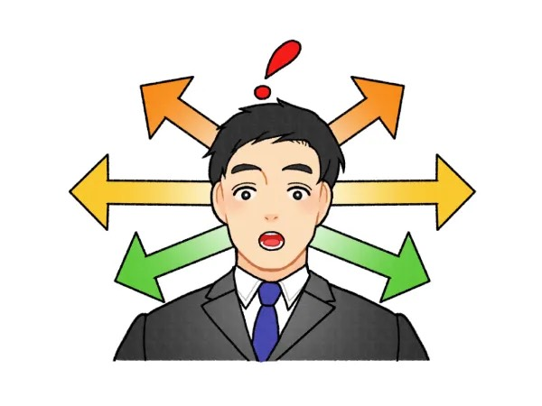
The Awareness Cycle
This document outlines key values to help you get the most out of Wevox. Please refer to these tips to help you interpret your Wevox Engagement Scores.
At Wevox, our primary focus is helping you turn insights from visualized team data into meaningful action.
To help you get the most from your data, we've outlined five principles of what we call The Awareness Cycle — key points for recognizing and acting on insights gained using Wevox. We hope you'll keep these tips in mind as you uncover new ideas and drive positive change in your organization.
Don’t only
Try this
Don’t only
Try this
Don’t only
Try this
Identify Weak Points
Identify Strong Points!
Assess the Situation, Plan Solutions
Identify Changes, Find the Cause!
Analyze On Your Own
Analyze as a Team!
How the Awareness Cycle Works
Refer to this guide before checking your latest Wevox data! A solid code of conduct can lead to improved engagement.
Keep these five principles in mind as you evaluate your Wevox score. You'll might be surprised at what you uncover!
Don’t only
Try this
Don’t only
Try this
Talk about these principles with your team and make them your own! Feel free to modify them to fit your team's style, vision and values.
Broaden Action
Broaden Perspective!
Focus on Engagement
Focus on the Mission!

